Slide 1
Health Sciences Library
New Faculty Orientation
Gail Y. Hendler, MLS
Director
Jonna Peterson, MLIS, AHIP
Associate Director
August 11, 2021

Slide 2
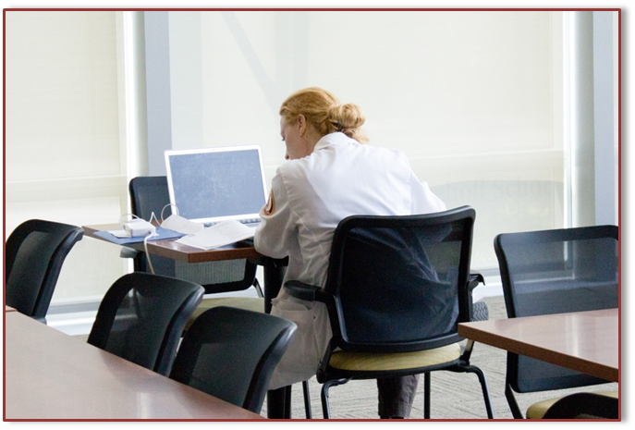
Welcome
First floor, Marcella Niehoff School of Nursing
Librarian support available M-F. 9-5
Staffed Service Desk Hours:
  M-F 8:30am – 11am and 3-5pm
After-hours access via LUC/LUMC ID swipe at SSOM
4 group study and Quiet Study
Access to public PC’s and Macs
Wireless printing
Self-service photocopy, scan and print
Charging stations, public PC and Macs
hsl@luc.edu
708-216-9192
library.luhs.org

Slide 3
Librarian Support: hsl@luc.edu
  Information skills training for faculty development, patient care, and curriculum support. Delivered to department meetings or class.
  Consults and literature searches. Expert search and systematic reviews support.
  iThenticate plagiarism reports.
  Lunch time library workshops.
  Create and curate topic, course, and other research guides.
  Citation management software support.
  Request needed books and articles not licensed by the library. Delivered to your desktop at no charge.

Slide 4
Information Skills Training
Faculty Development
  In-service training on a variety of information resources and library updates delivered at department meetings and Grand Rounds
Curriculum Support for UME and GME and Clinical Nursing
  Friday School (Internal Medicine Residency/LUMC)
  Evidence Based Searching (Family Medicine Clerkship)
  Citation management and PubMed for Researchers (Biomedical Graduate School)
  Searching for Evidence (Clinical Ladder)

Slide 5
Online Collections
Bookmark the library web site: library.luhs.org
Thousands of electronic books and journals
Article and research databases
Patient care decision-making tools
Protocols and lab methods
Author tools
Citation management software
PubMed@Loyola links to licensed content
All-electronic journals collection in support of teaching/learning, research, patient care and publishing
Access licensed resources via UVID/password or 4 x 4 and password
Citrix cannot save or download content. Open a new browser to find and access library resources from the home page

Slide 6
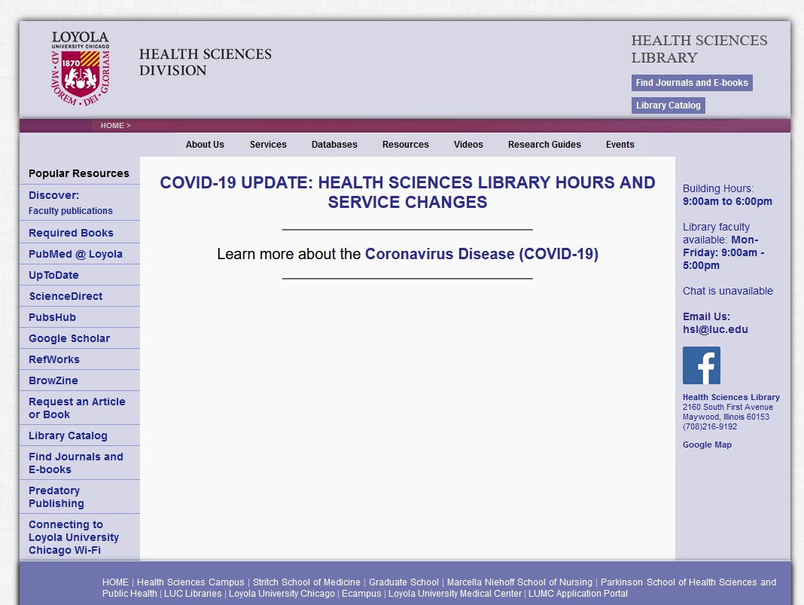
Bookmark the library homepage:
library.luhs.org
Not on your own device?
Google Loyola Health Sciences Library
Find book platforms (Clinical Key) under the Resources tab
Find training and other videos under the Videos tab
Find article and index databases under the Databases tab

Slide 7
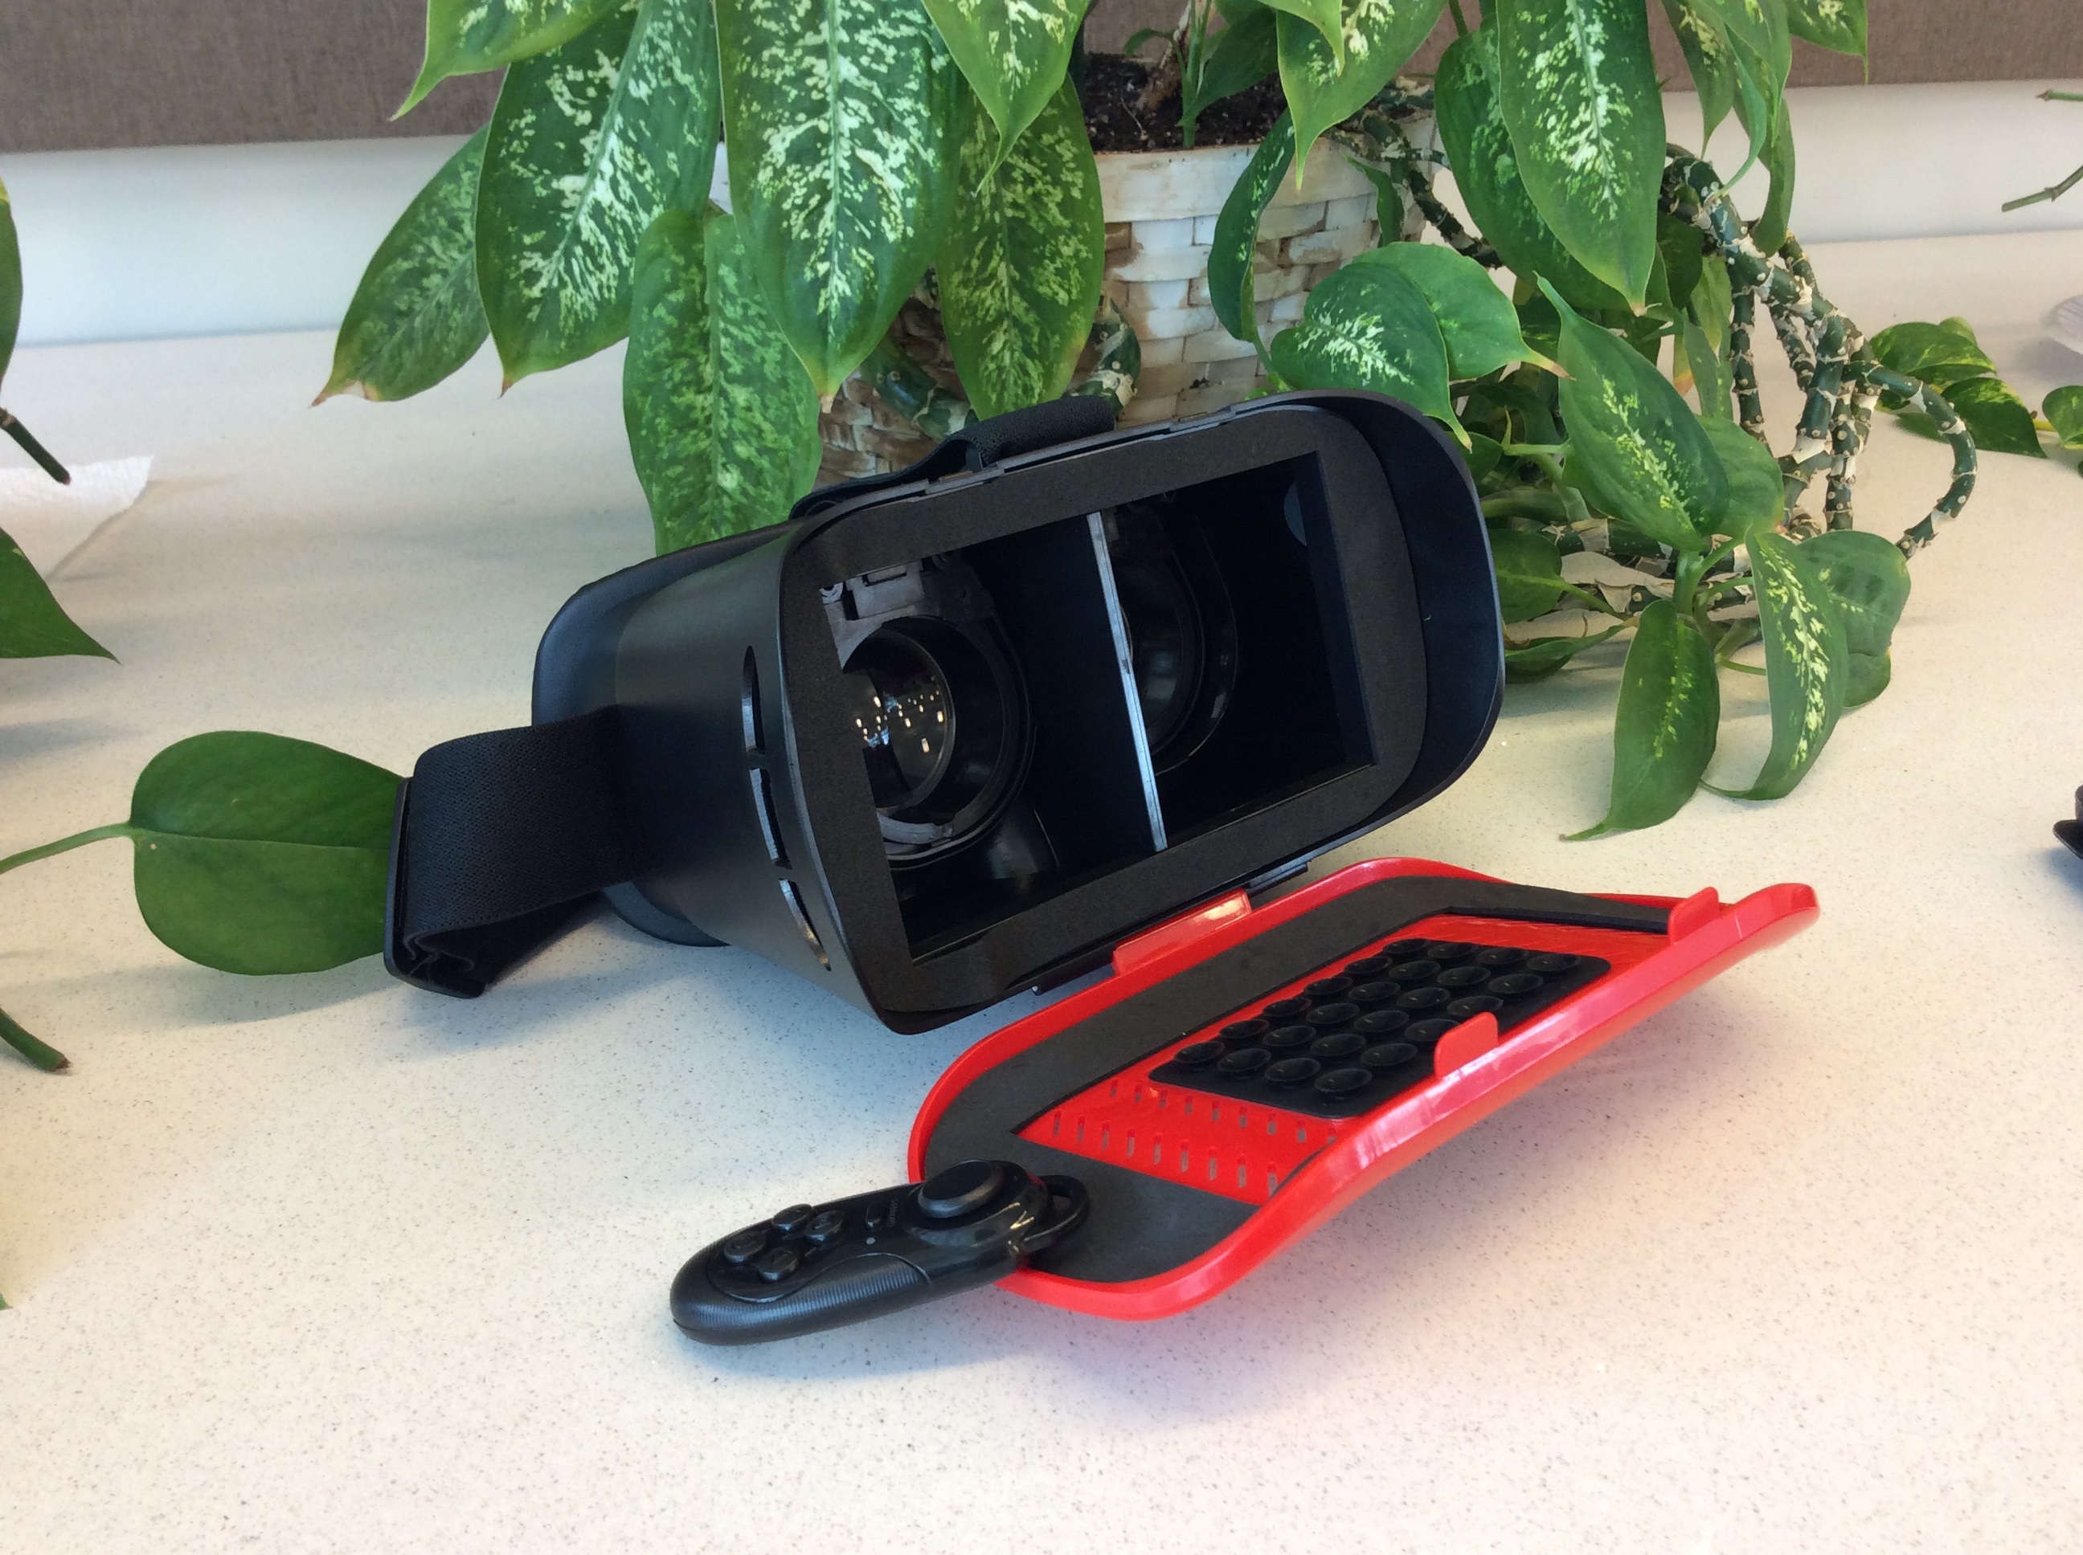
Productivity Tools
Available for up to 3 hours:
  Chargers, Ethernet cables, mice
  MacBooks and laptops
  iPads
  Wacom tablet
Available for up to 7 days:
  iPad minis

Slide 8
Scholarly Publishing Support
15% discount article processing charges to affiliated (LUMC) authors for manuscripts accepted to Biomed Central and SpringerOpen journals via institutional membership
BMJ Case Reports “Fellowship Code” to cover cost of subscription required for all authors of accepted manuscripts. Publishers may charge additional article fees.
Support for copyright, predatory publisher questions, and finding where to publish

Slide 9
Discover: Faculty Publications
Web-based, open-source application created by librarians for libraries
Searches PubMed Biosis Previews, CINAHL and Global Health databases monthly
Goals:
  Promote and market HSC faculty research and scholarship to the world
  Identify potential collaborators/mentors
  Showcase HSC experts to potential students, faculty and staff
Find Discover on the HSL homepage under Popular Resources
Faculty receive email requests to deny/confirm authorship
Confirmed references are exported to Discover

Slide 10
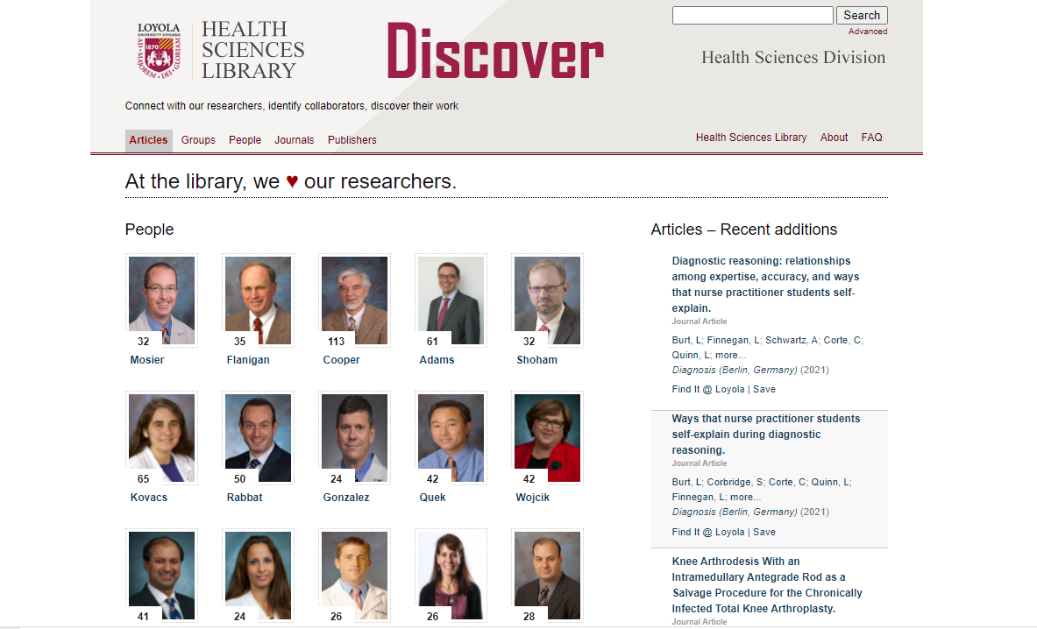

Slide 11


